Slide 1
Raphael painting analysis: Random cropping leading to high variance
(Group VI)
M Usman Maqbool Bhutta,
Candi Zheng
Lan Yuan

Slide 2
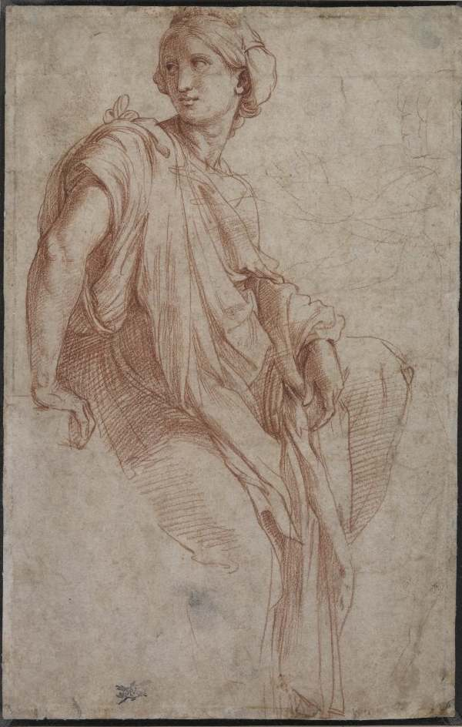
Introduction
For Feature Extraction and Transfer Learning, the Raphael dataset is used [1].
This dataset contains a 28 digital painting of Raphael or forgeries. There are 13 genuine, 9 not sure and 6 disputed images.
We compared the performance between transfer learning and ScatNet and discuss the factors affecting in the final performance.

Slide 3
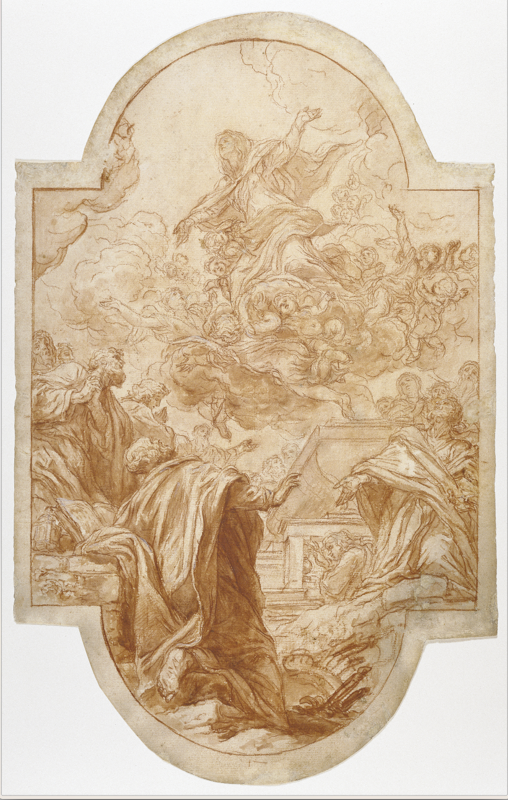
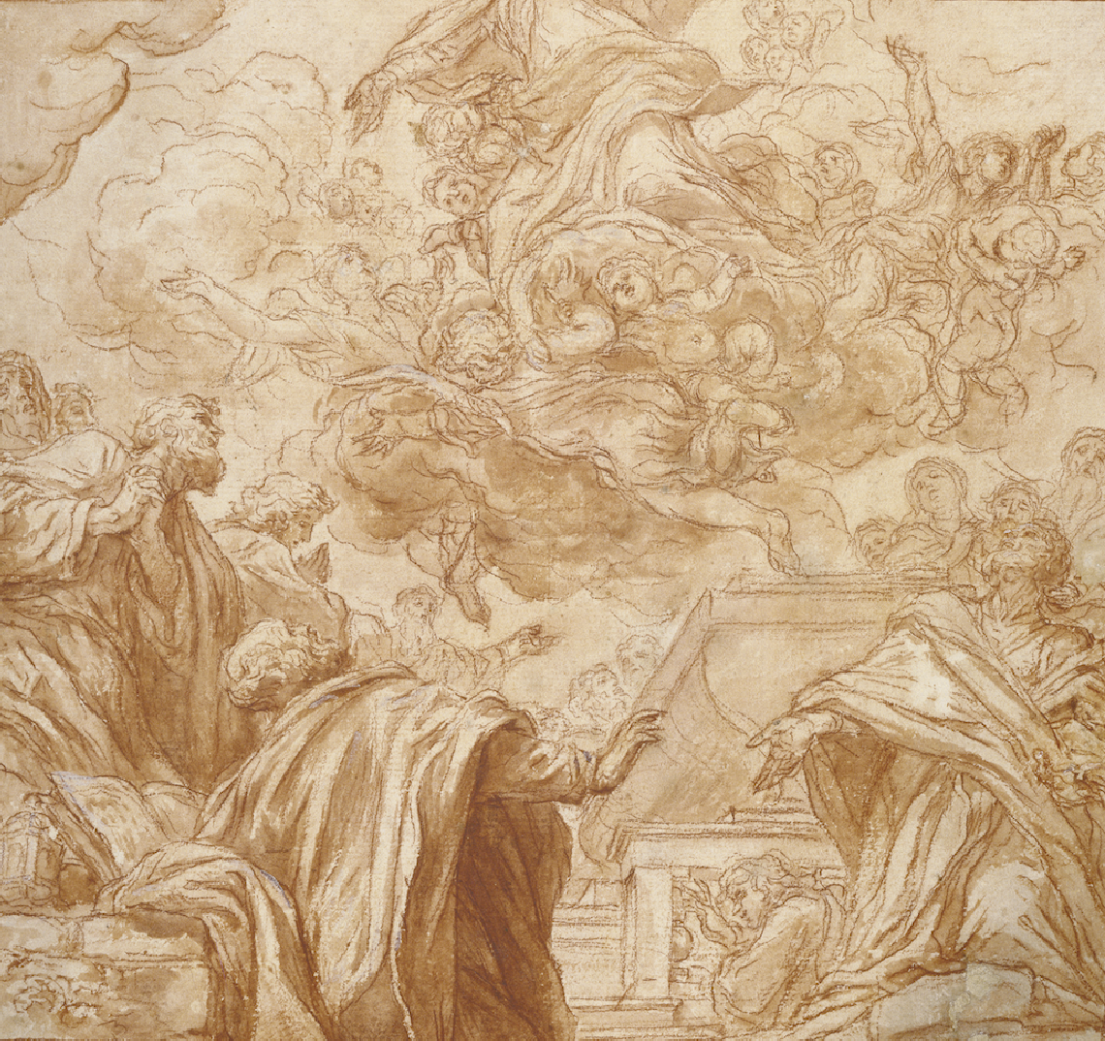
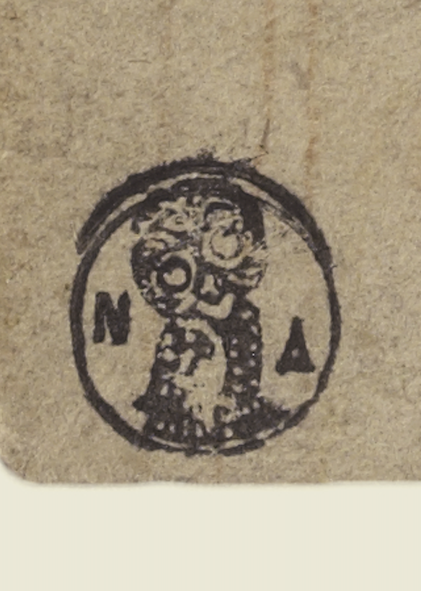
Method | Data Cleaning
We processed the image manually:
Remove edges
Remove stamps

Slide 4
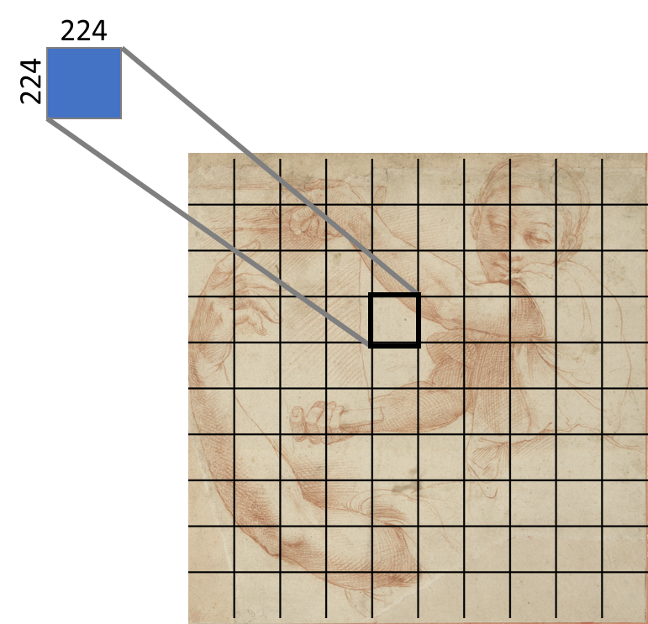
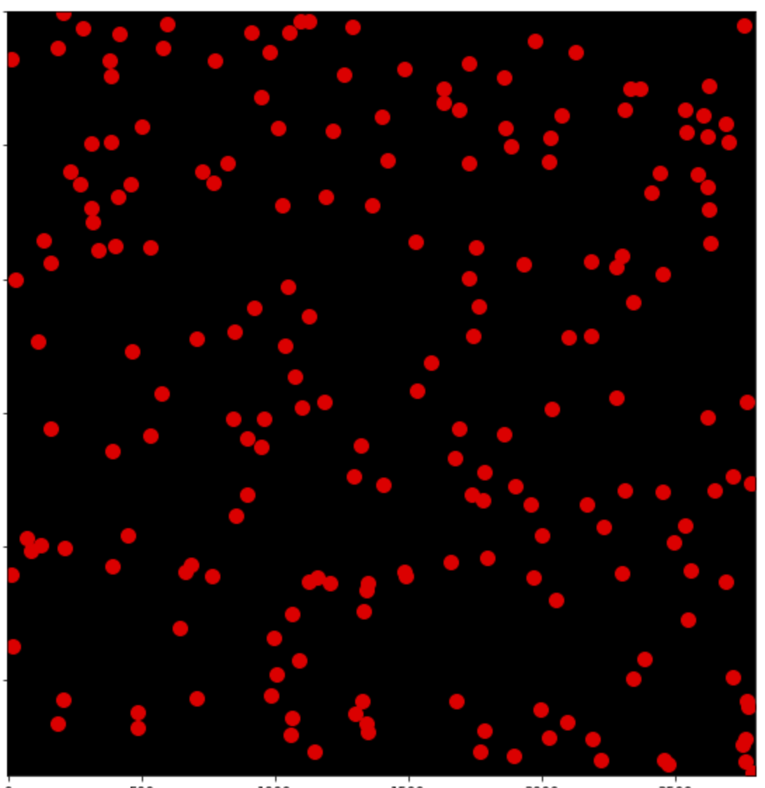
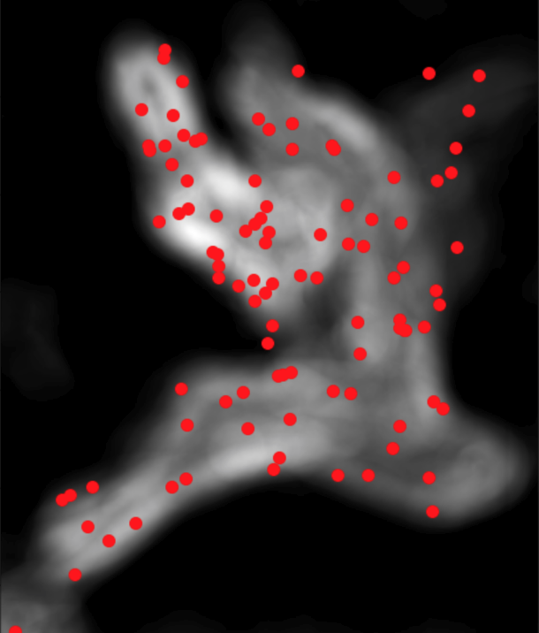
Method | Cropping
Three different types of methods are used for cropping the image. We used 100 crops and 200 crops
Random
Entropy random
Sequential

Slide 5
Method | Scaling
The window size is fixed further resized to:
Scale 0: Raw
Scale 1: Avg(Height,Width): 1500 pixels
Scale 2: Avg(Height,Width): 375 pixels

Slide 6
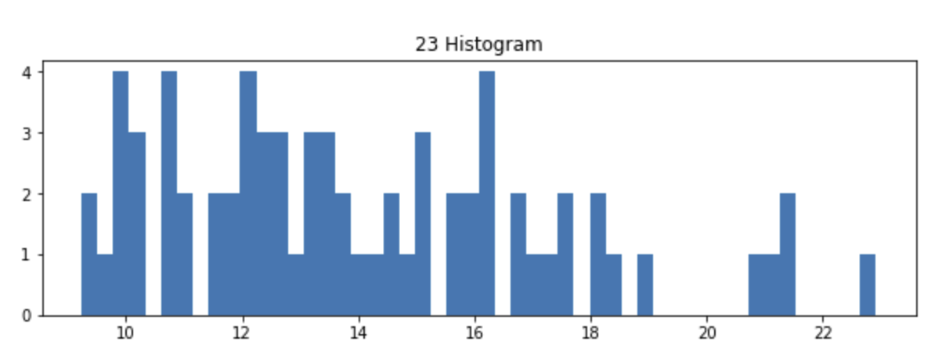
Method | Heuristic
For random and sequential cropping, paths variance are calculated and top 50% are selected
A histogram of variance of cropped picture 23

Slide 7
Method | Feature Extractor
VGG16：
This model is a classic convolution neural network, pre-trained on ImageNet with 16 convolution layers and small respective field. We froze the weights for network and deleted the final fully connected network to make it an feature extractor.
ResNet18:
It’s a residual learning framework with 18 layers. We also remove the final FC layer and freeze the weights of this pre- trained model also trained on ImageNet.
Scat Net (J=4,5)：
Wavelet scattering network (Scat Net) computes a translation invariant image representation. With an image X, we use 2- layer Scat Net to output a 241,391 dim feature vector.

Slide 8
Method | Evaluation:
Cross Validation: Image-wise Leave-One-Out cross validation
Scoring: Percentage of patches labelled positive/100
Metric: AUC(area under curve) and Accuracy( Threshold 0.5, equivalent to majority voting )

Slide 9
Results | CROSs Validation – Best Results
The result is averaged over 3 run
The Best AUC
The Best Acc
AUC | ResNet | VGG | Scat4 | Scat5
SVM | 0.731 | 0.721 | 0.613 | 0.600
LR | 0.722 | 0.741 | 0.611 | 0.63
RF | 0.846 | 0.8563 | 0.881 | 0.889
Acc | ResNet | VGG | Scat4 | Scat5
SVM | 0.714 | 0.667 | 0.587 | 0.571
LR | 0.667 | 0.667 | 0.571 | 0.556
RF | 0.746 | 0.762 | 0.794 | 0.841
Scat5 did have the best performance.

Slide 10
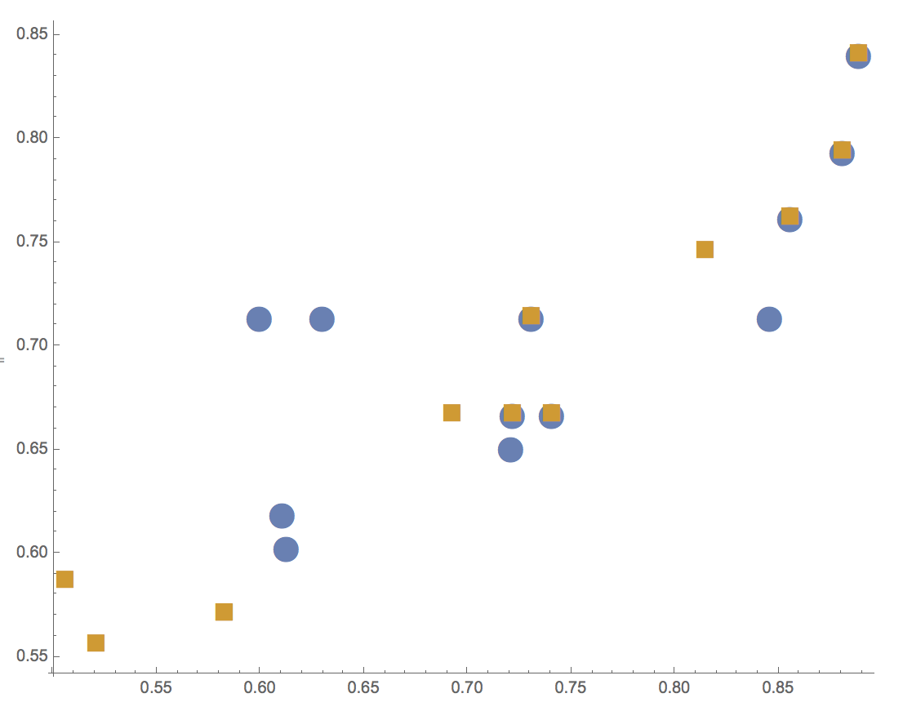
Correlation between AUC & ACC
Acc
Blue: Best AUC
Orange: Best Acc
AUC

Slide 11
Results | compare: Repeat previous work
Our best result for raw random cropping (averaged over 3 run)
The Best AUC
AUC | ResNet | VGG | Scat4 | Scat5
RF | 0.781 | 0.724 | 0.643 | 0.665
The Corresponding Accuracy
Acc | ResNet | VGG | Scat4 | Scat5
RF | 0.587 | 0.651 | 0.54 | 0.643
Random Cropping over raw image
Failed to reproduce previous result

Slide 12
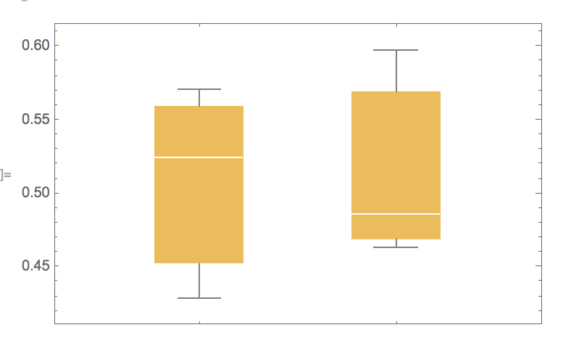
Analysis | Variance, SVM
Variance, raw scale random cropping
 | Random, Scat5, SVM
 | Acc | AUC
Run1 | 0.571 | 0.486
Run2 | 0.524 | 0.597
Run3 | 0.429 | 0.463
Acc
AUC
High variance

Slide 13
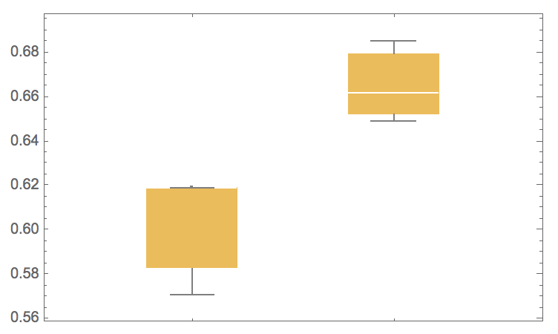
Analysis | Variance, RF
Variance, raw scale random cropping
 | Random, Scat5, RF
 | Acc | AUC
Run1 | 0.619 | 0.685
Run2 | 0.619 | 0.648
Run3 | 0.571 | 0.662
AUC
Acc
Random Forest reduces the variance, hence it is more reliable
Smaller variance

Slide 14
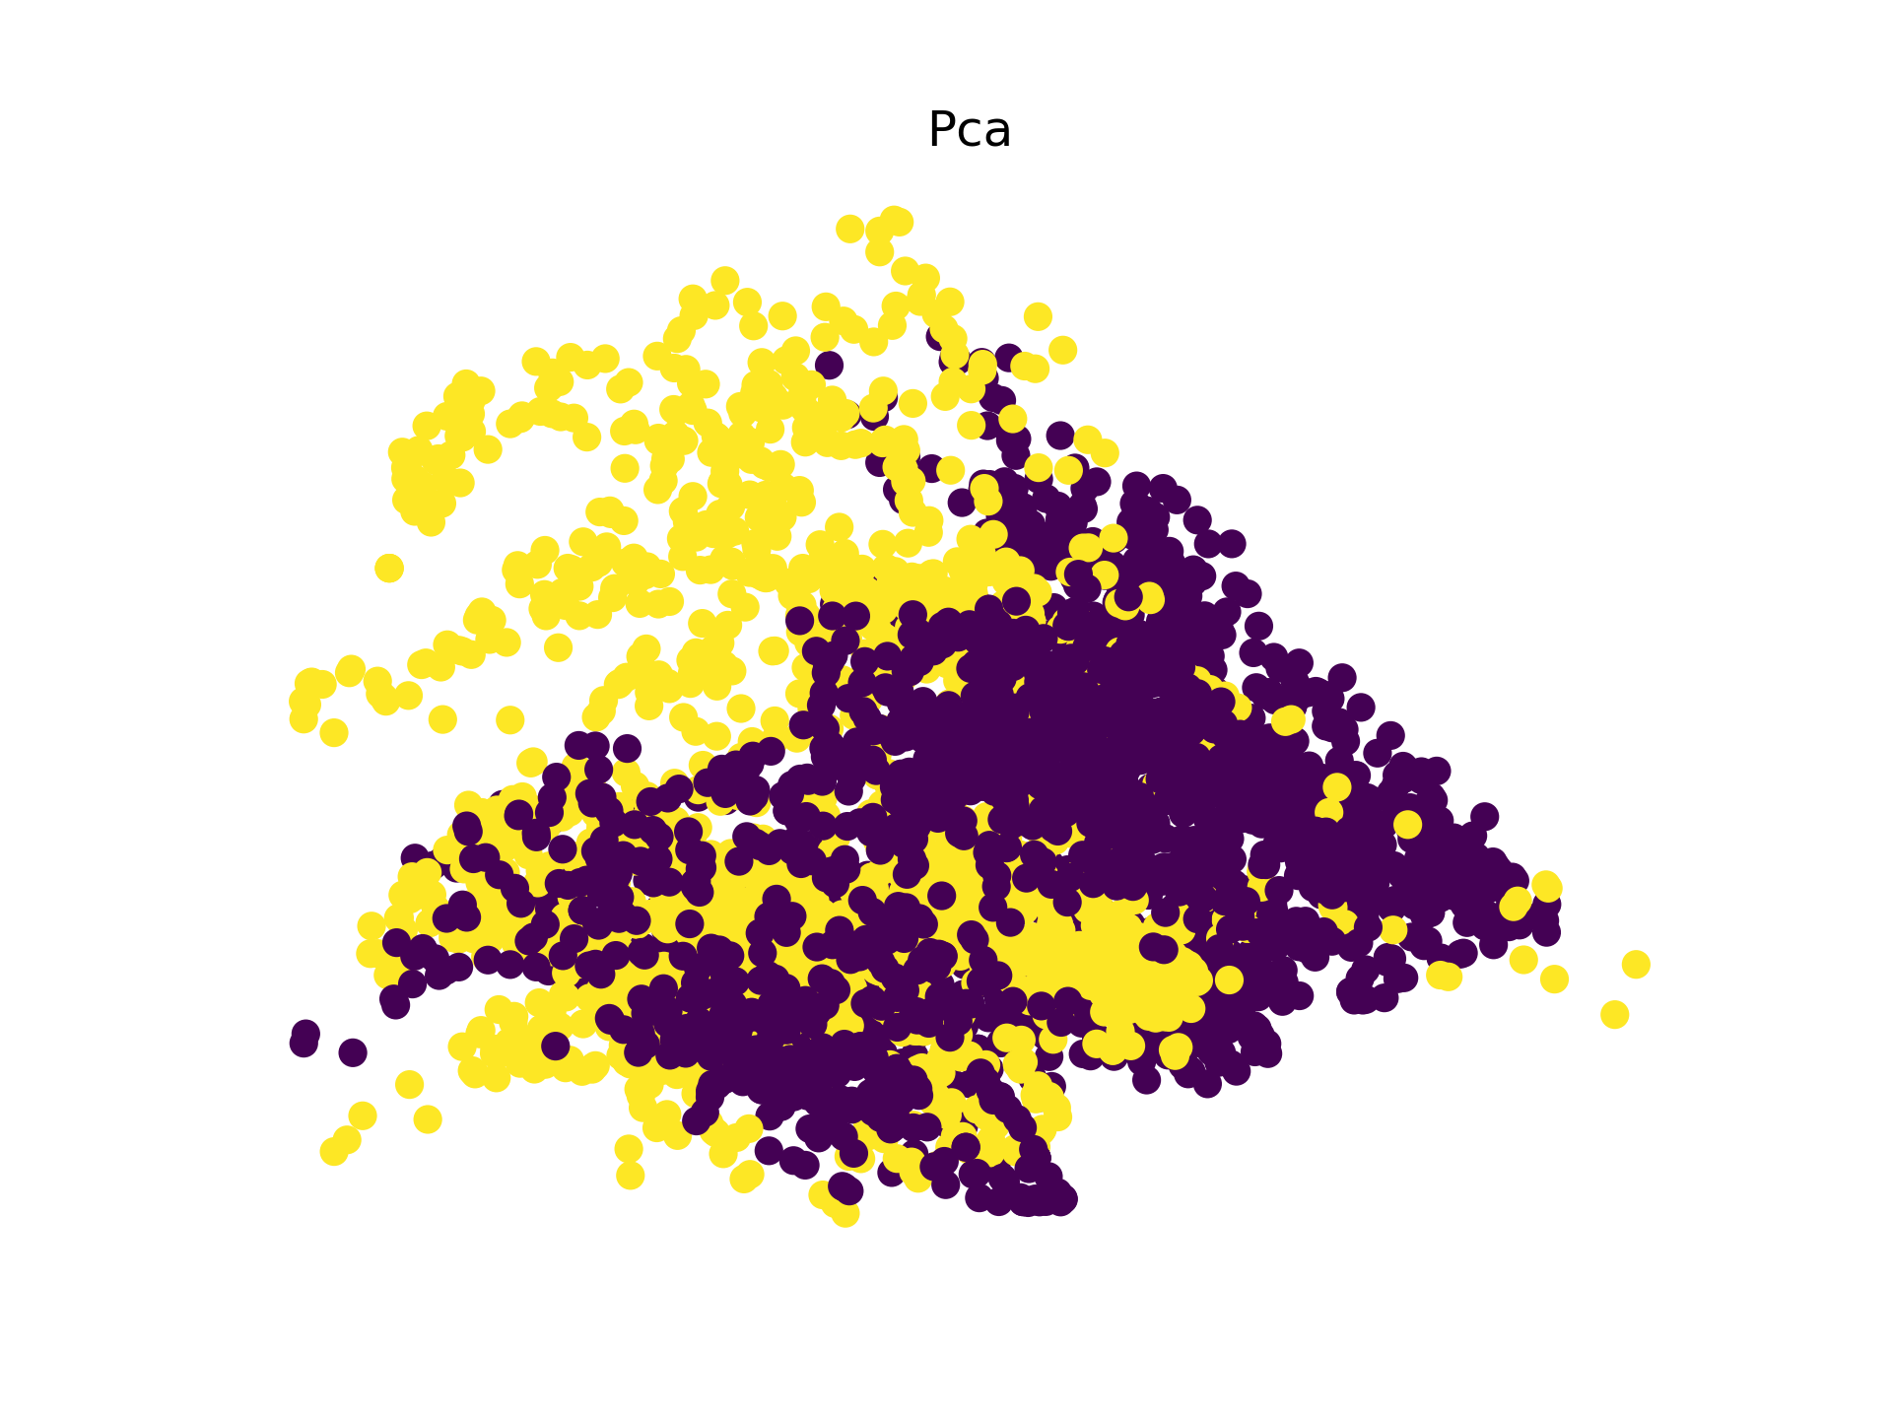
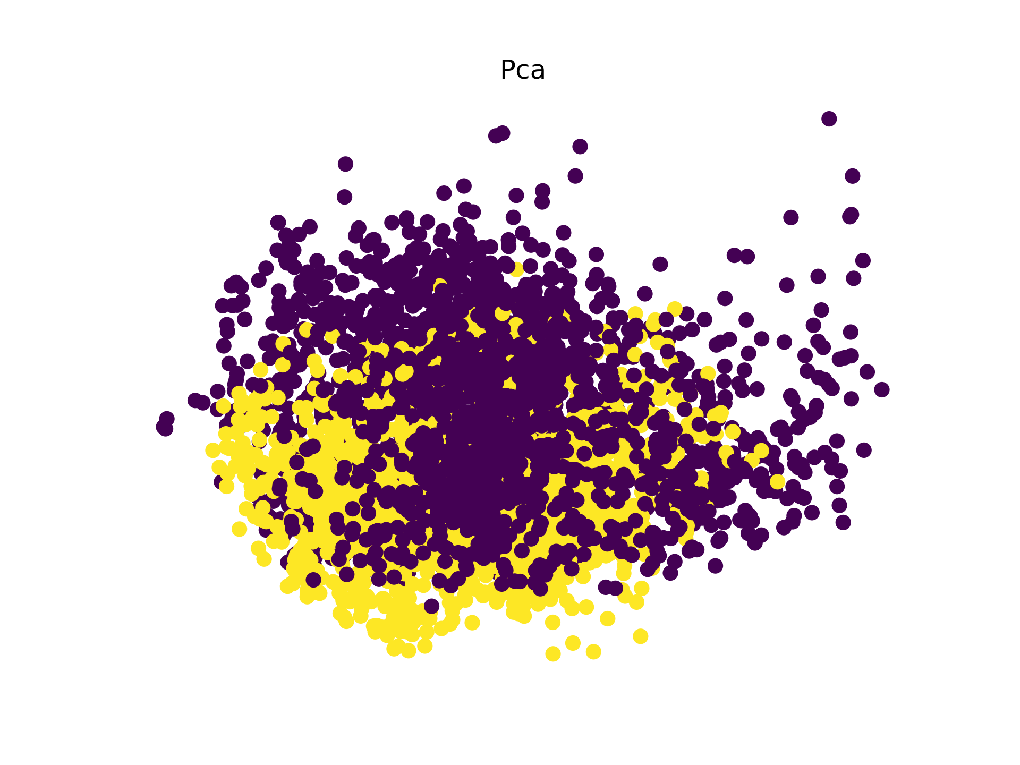
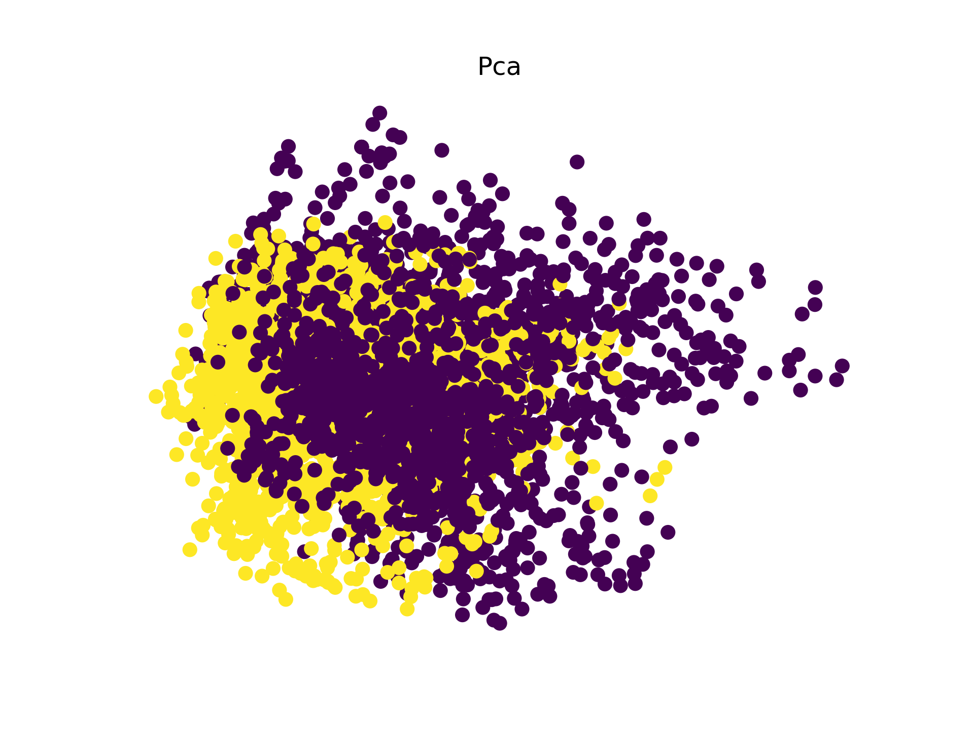
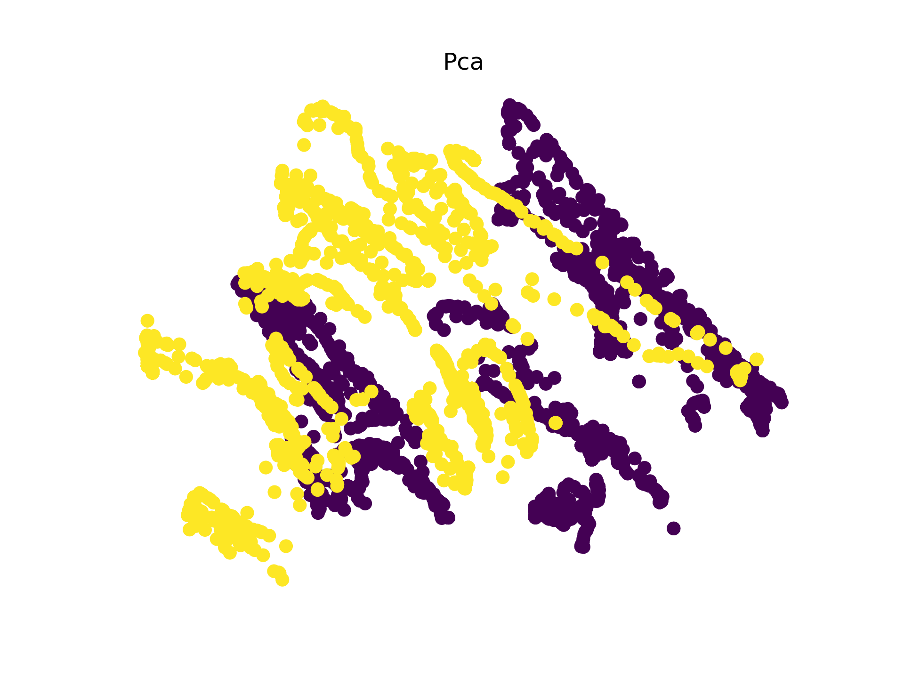
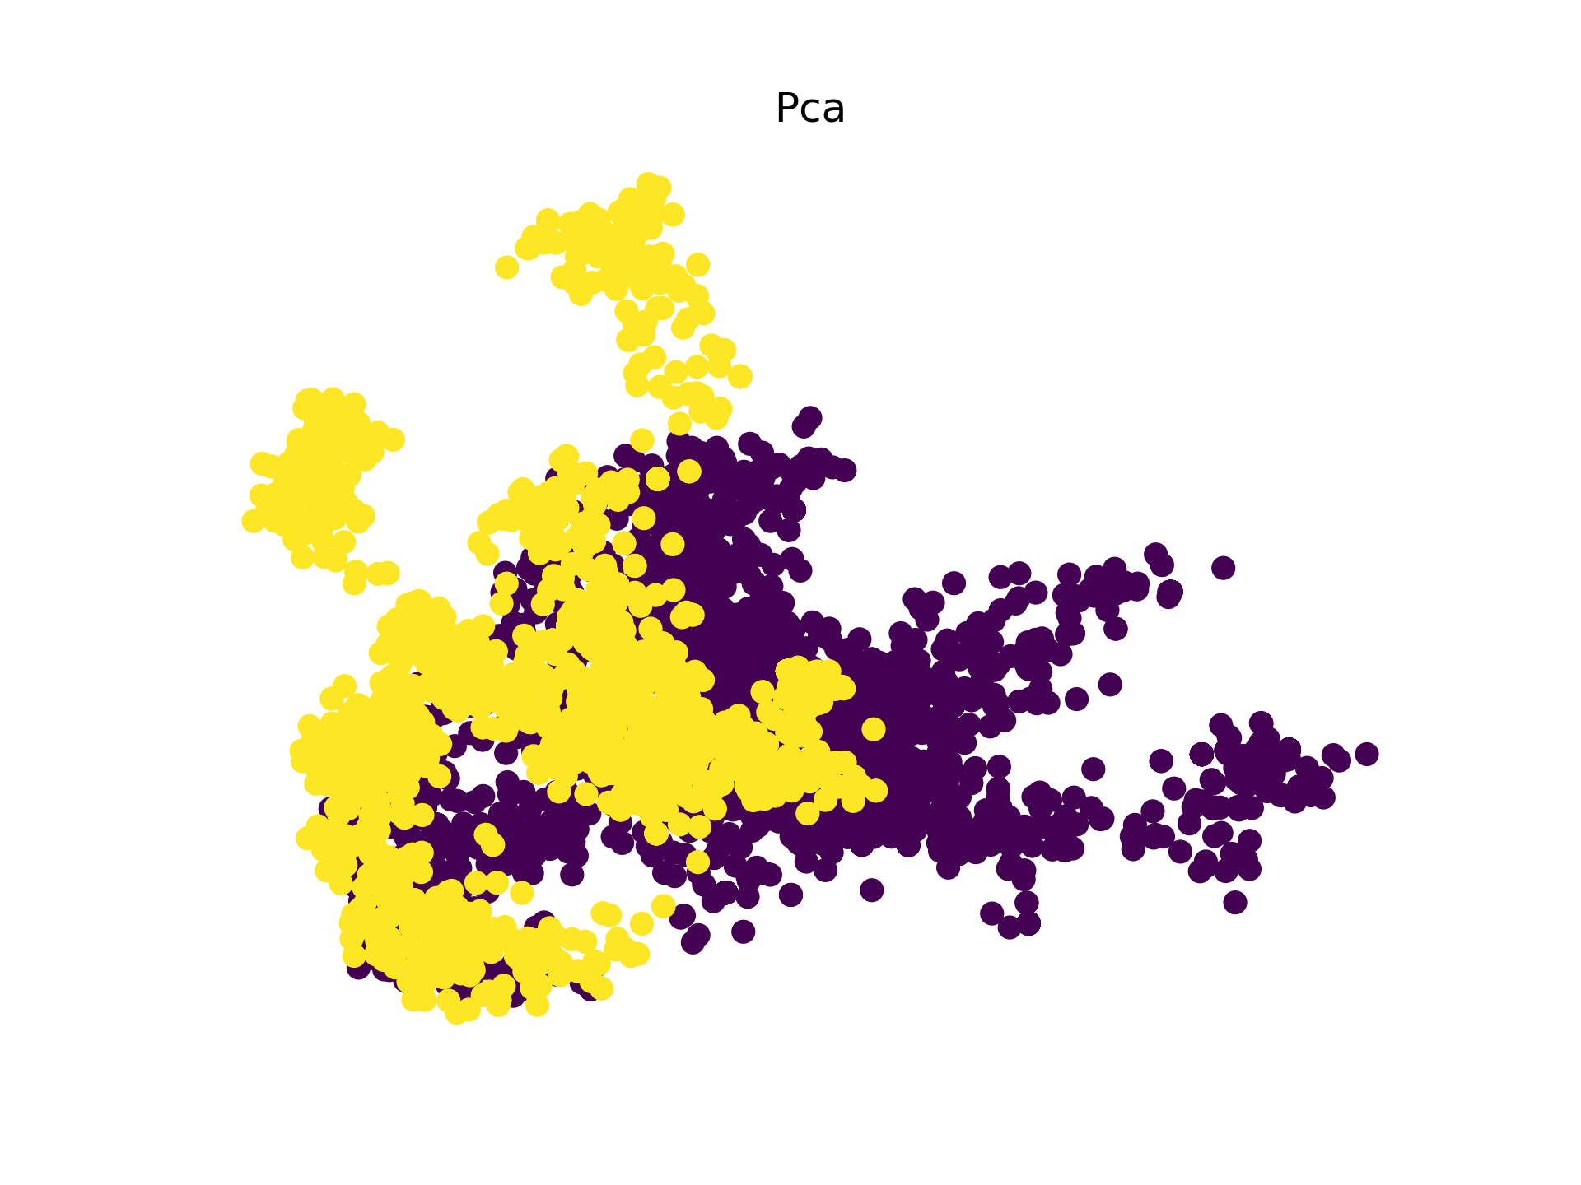
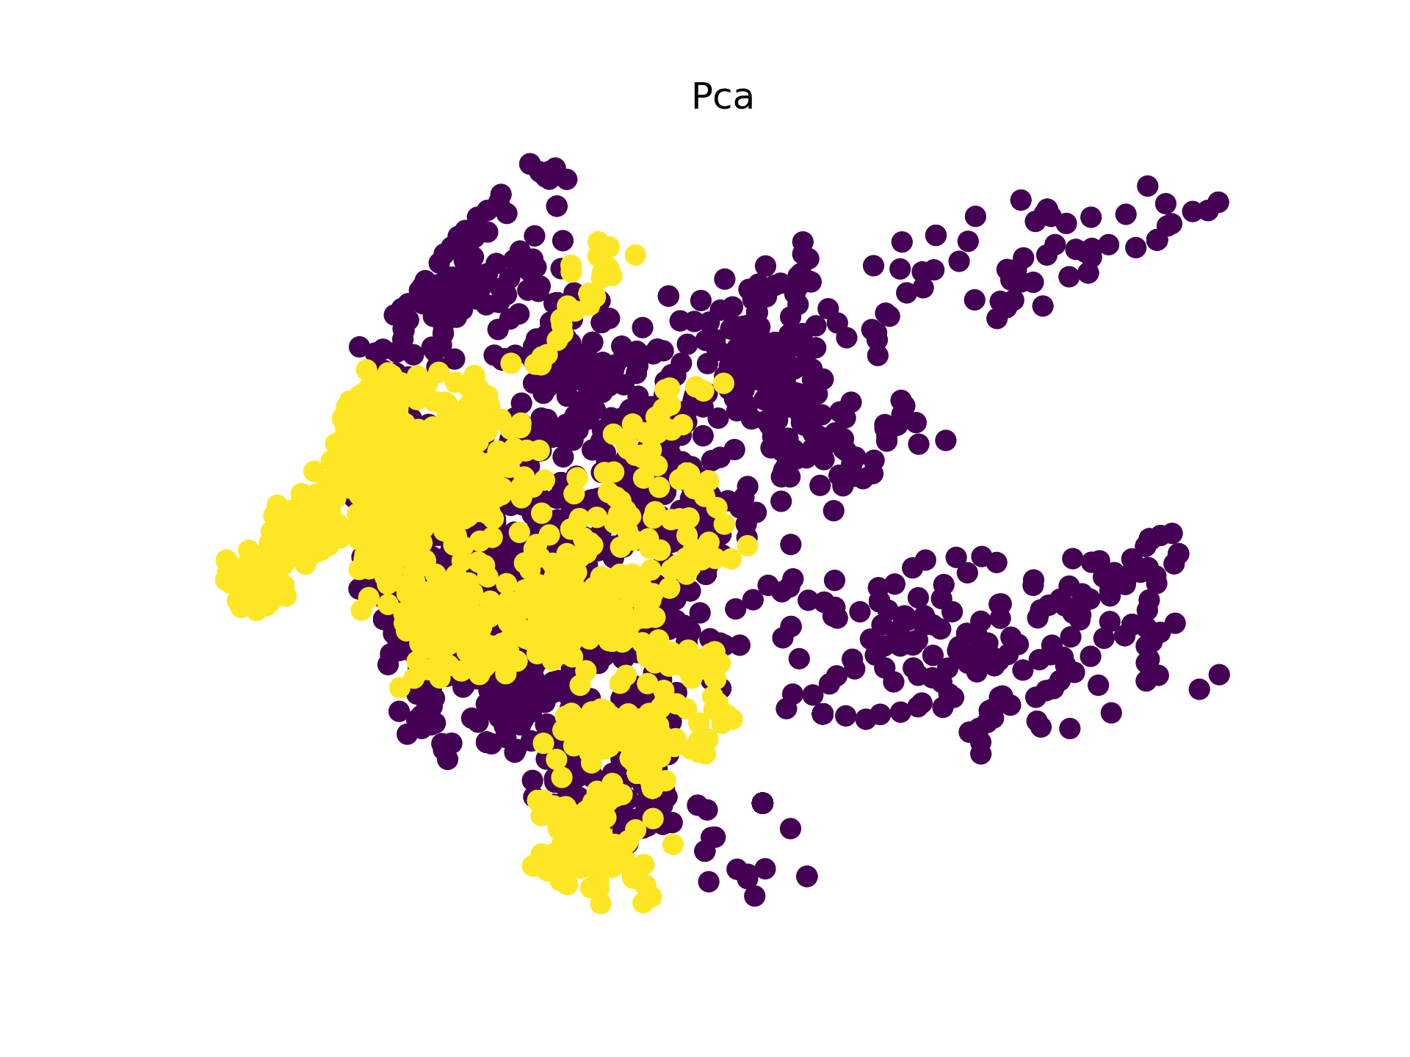
VISUALIZATION | pca
1500pix_random_200_Scat
1500pix_random_200_Resnet
1500pix_random_200_VGG
375pix_entropyrandom_200_Scat
375pix_entropyrandom_200_Resnet
375pix_entropyrandom_200_VGG

Slide 15

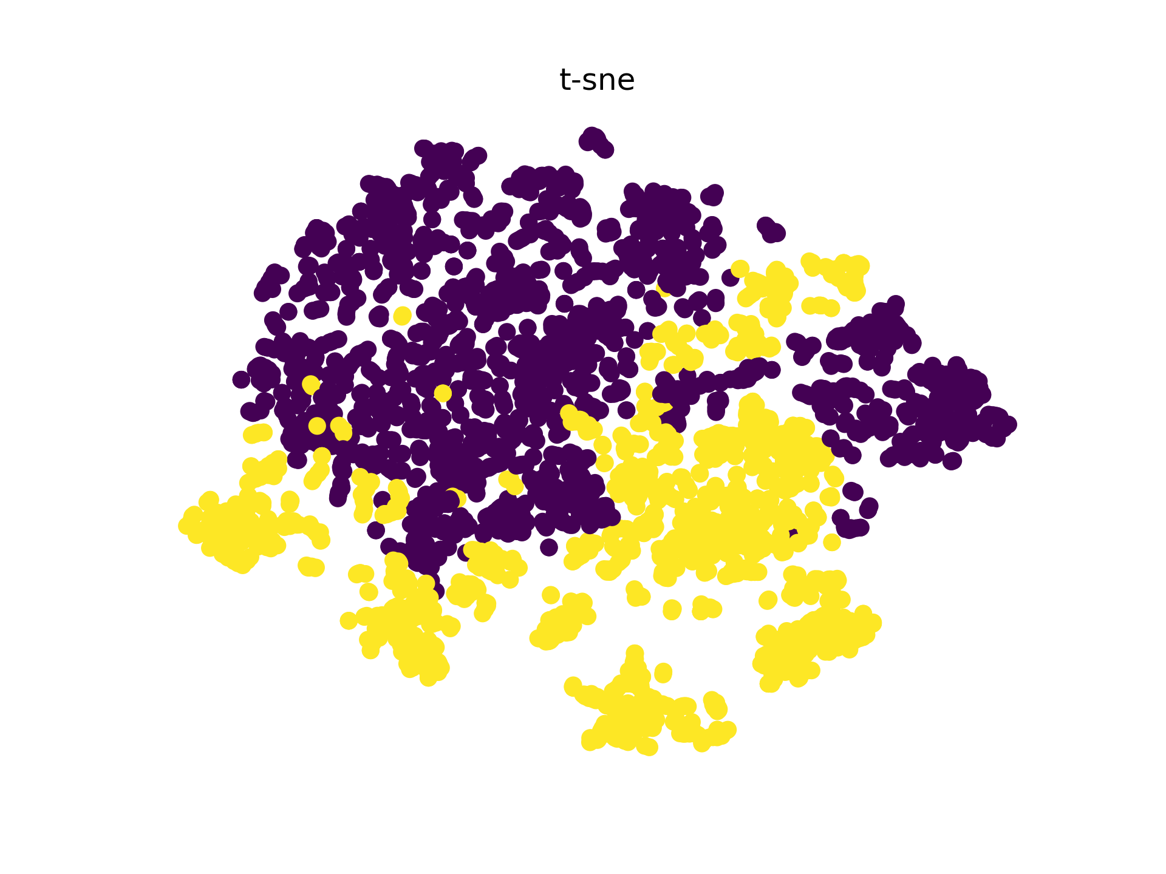
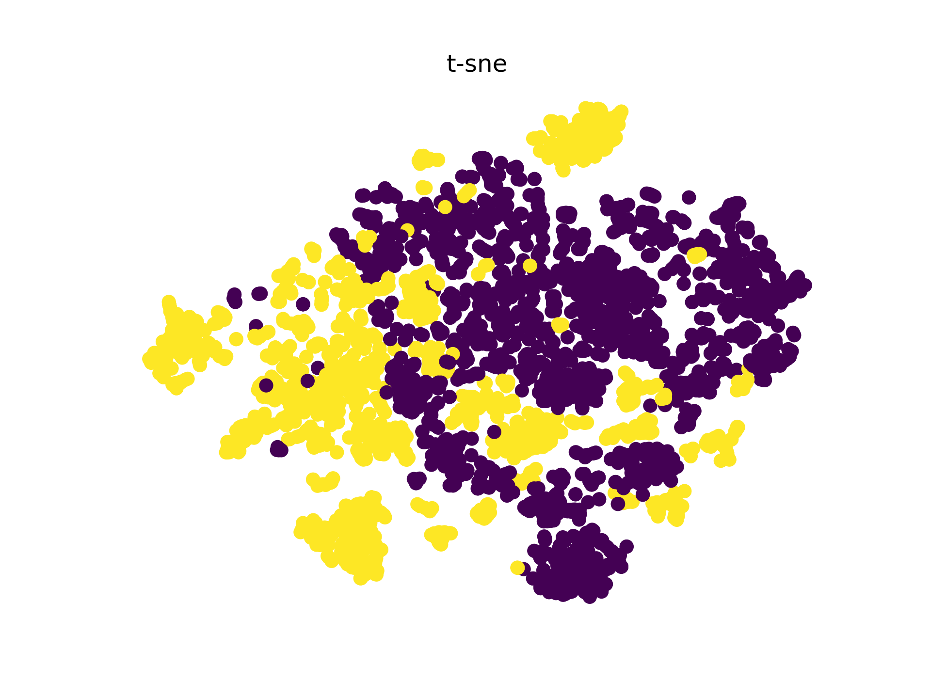
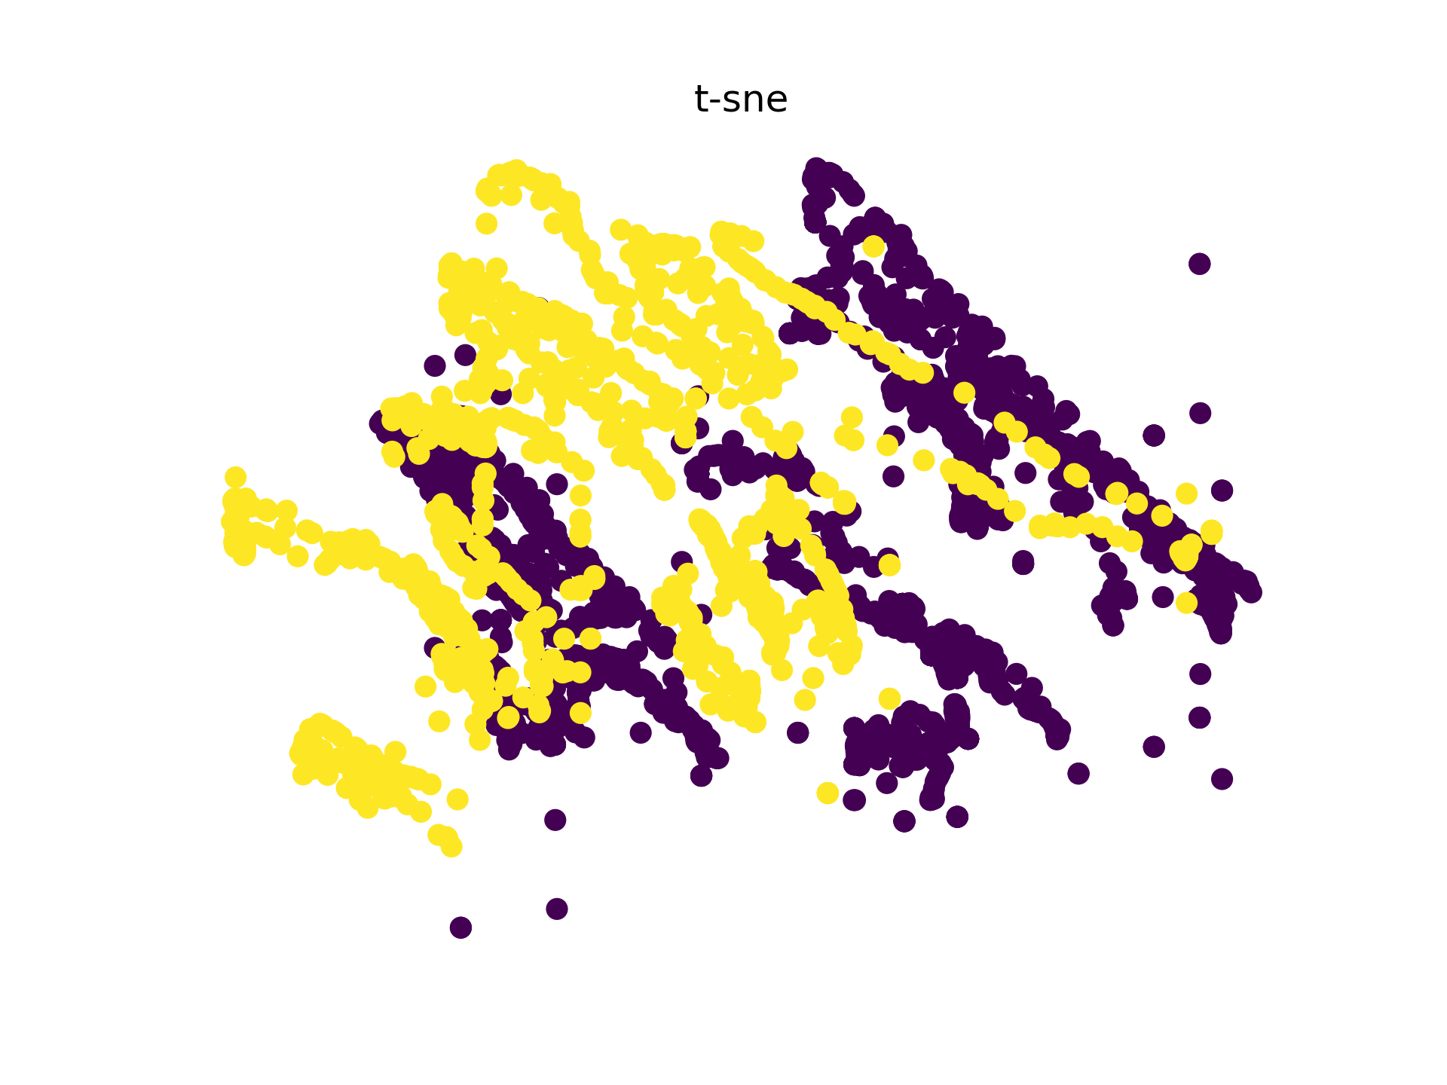
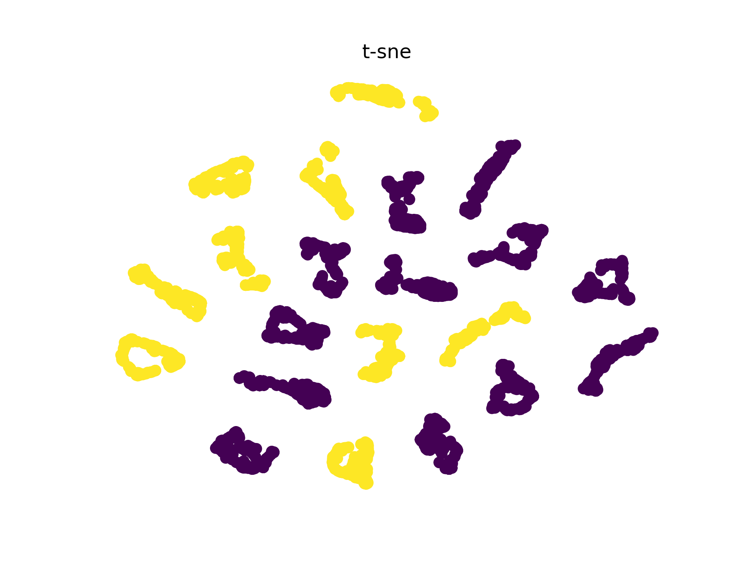
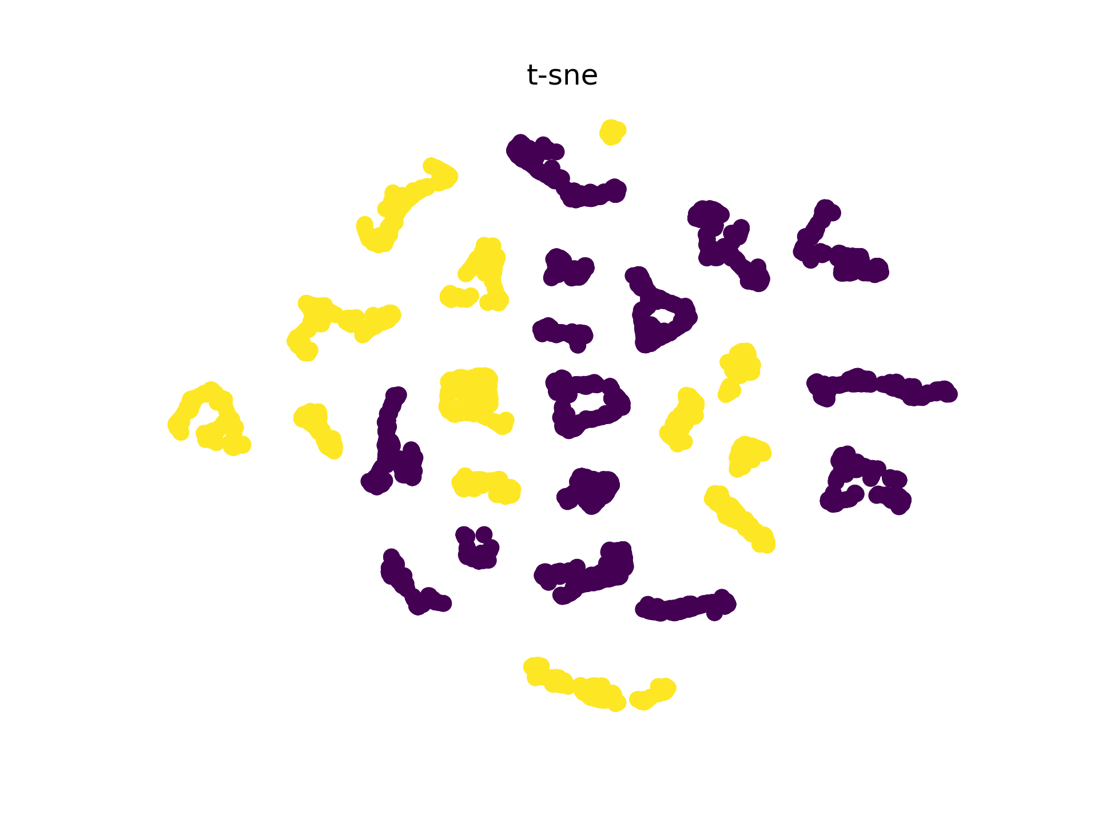
VISUALIZATION | T-SNE
1500pix _random_200_Scat
1500pix _random_200_Resnet
1500pix _random_200_VGG
375pix_entropyrandom_200_Scat
375pix_entropyrandom_200_Resnet
375pix_entropyrandom_200_VGG

Slide 16
Analysis | Cleaning
Cleaning | Avg AUC | Avg Acc | Max AUC | Max Acc
Not Cleaned | 0.690 | 0.642 | 0.894 | 0.857
Cleaned | 0.680 | 0.640 | 0.898 | 0.857
Cleaning
Average is taken over all model trained.
No significant difference

Slide 17
Analysis | Cropping and scalling
Best Cropping and their Scale results, average over all model trained on cleaned data
Scale | Cropping | Avg AUC | Avg Acc
1500pix | Sequential | 0.716 | 0.669
1500pix | Random | 0.676 | 0.632
375pix | Entropy | 0.662 | 0.690
375pix Entropy have best result
The idea of focusing on sketch patches doesn’t help
375pix scale Entropy Cropping is best

Slide 18
PREDICTION
The prediction result at False Positive rate = 20% (RF)
 | AUC | 1 | 7 | 10 | 23 | 25 | 26 | 20
Scat | 0.89 | ✖ | ☑ | ✖ | ✖ | ✖ | ✖ | ✖
VGG | 0.86 | ✖ | ✖ | ✖ | ✖ | ✖ | ✖ | ☑
Res | 0.85 | ✖ | ✖ | ✖ | ✖ | ✖ | ✖ | ✖
Conclusion: The model still don’t have the ability to distinguish. Fig7 and 20 might be True

Slide 19
Summary
Variance is high for random cropping.
RF reduce some variance, hence more reliable
it is necessary to run average between runs or use ensemble methods to reduce variance.

Slide 20
Method | Pre-processing
We processed the image by cropping the edges and removed stamps manually.
We resized all images with avg. dimension of 3000 as scale 1.
And further resized to scales 0.5,0.25 and 0.125 respectively.
Three different types of methods are used for chopping the image.
Sequentially(Seq)
Random(Ran)
We sequentially generated the patches of size 224x224 as shown in above figure.
Entropy Random(Ent)

Slide 21
Method | Pre-processing
We processed the image by cropping the edges and removed stamps manually.
We resized all images with avg. dimension of 3000 as scale 1.
And further resized to scales 0.5,0.25 and 0.125 respectively.
Three different types of methods are used for chopping the image.
Sequentially(Seq)
Random(Ran)
We sequentially generated the patches of size 224x224 as shown in above figure.
Entropy Random(Ent)
We calculated the local entropy, and the cropping center (red point) is selected with probability proportional to it.
After chopping, patches with top 50 % variance are selected.

Slide 22
Method | Cross Validation:
We used;
image-wise Leave-One-Out cross validation
to calculate accuracy patch-wise, and calculate AUC(area under curve) based on the accuracy.

Slide 23
Analysis
Two main factors, chunks number, reception filed ( affected by scale ), determines the final outcome.
Entropy random cropping (Fixing the chunks number) achieve the best performance at smallest scale (largest reception field) due to the full coverage of picture.
For same reception field (scale), large chunks number reduce the variance and increase performance.
Keeping the coverage ( reception field x number ), Sequential cropping result varies, the outcome gets and extreme value at a balanced reception field and chunk numbers.

Slide 24
Results | CROSs Validation
 | Random |  | Entropy Random |  | Classifier | Scale | Feat
 | Acc | AUC | Acc | AUC
Run1 | 0.667 | 0.657 | 0.619 | 0.694 | SVM | 0.5 | Resnet
Run2 | 0.571 | 0.704 | 0.524 | 0.644 | SVM | 0.5 | Resnet
Run3 | 0.714 | 0.727 |  |  | SVM | 0.5 | Resnet

Slide 25
Results | CROSs Validation
AUC | Acc | Estimator | Num | run | scale | type
0.894 | 0.81 | RF | 200 | Run1 | 0.5 | Random
0.861 | 0.714 | RF | 200 | Run2 | 0.125 | Random
0.852 | 0.714 | RF | 400 | Run1 | 0.5 | Random
0.759 | 0.714 | LR | 100 | Run2 | 0.5 | Entropy Random
0.75 | 0.714 | SVM | 100 | Run1 | 0.125 | Entropy Random
AUC | Acc | Estimator | Num | run | scale | type
0.852 | 0.762 | RF | 400 | Run2 | 0.125 | random
0.843 | 0.714 | RF | 400 | Run1 | 0.125 | random
0.833 | 0.81 | RF | 200 | Run1 | 0.125 | random
0.796 | 0.762 | SVM | 400 | Run1 | 0.125 | random
0.773 | 0.667 | LR | 400 | Run1 | 0.125 | random
ResNet18 Top 5
VGG16 Top 5
AUC | Acc | Estimator | Num | run | scale | type
0.87 | 0.762 | RF | 200 | Run3 | 0.5 | sequential
0.861 | 0.81 | RF | 200 | Run2 | 0.5 | sequential
0.852 | 0.762 | RF | 200 | Run1 | 0.5 | sequential
0.676 | 0.571 | SVM | 200 | Run1 | 0 | random
0.63 | 0.619 | LR | 400 | Run3 | 0 | random
AUC | Acc | Estimator | Num | run | scale | type
0.852 | 0.81 | RF | 200 | Run2 | 0.5 | sequential
0.843 | 0.857 | RF | 200 | Run3 | 0.5 | sequential
0.833 | 0.81 | RF | 200 | Run1 | 0.5 | sequential
0.657 | 0.762 | SVM | 200 | Run3 | 0.5 | sequential
0.63 | 0.571 | LR | 200 | Run1 | 0.125 | entropy_random
ScatNet (J=4) Top 5
ScatNet (J=5) Top 5

Slide 26
Conclusion
Transfer learning is slightly better than ScatNet, but ScatNet is more invariant to scale change due to its multiscale nature.
Cropping the picture while cleaning it using variance/entropy is crucial. A large number of crops (~ 800 each ), or a large reception field ( about half the picture with randomness crop ~100 ), helps to get a meaningful result, and they interact with each other to create an balance point.
It is hard to achieving large reception field and large number of data without affecting relative independence.
Focusing on one approach is more promising to achieve a better performance.

